Slide 1
Manual for Image Fusion

Slide 2
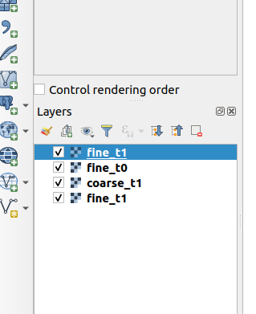
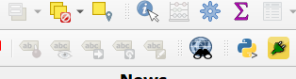
Load raster files into QGIS.
Install Image Fusion plugin from zip file (Refer Installation manual).
Step 1: Load Raster Files
Step 2 : Click on the icon

Slide 3
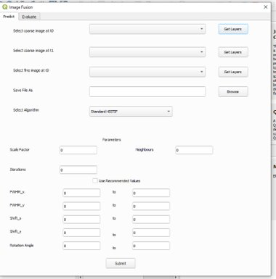
Image Fusion GUI appears as shown below.

Slide 4
Image Fusion Prediction
Step 1 : Click on Predict tab.
Step 2 : Load missing pixels file into QGIS.
Step 3 : Click on Get Layers button.
Step 4 : Select layer from combo box.
Step 5 : Click browse button, select
output directory and enter output file name.
Step 6: Select Algorithm from combo box.
Step 7 : Enter parameters or use recommended values
Step 8 : Click on submit button to run the program.

Slide 5
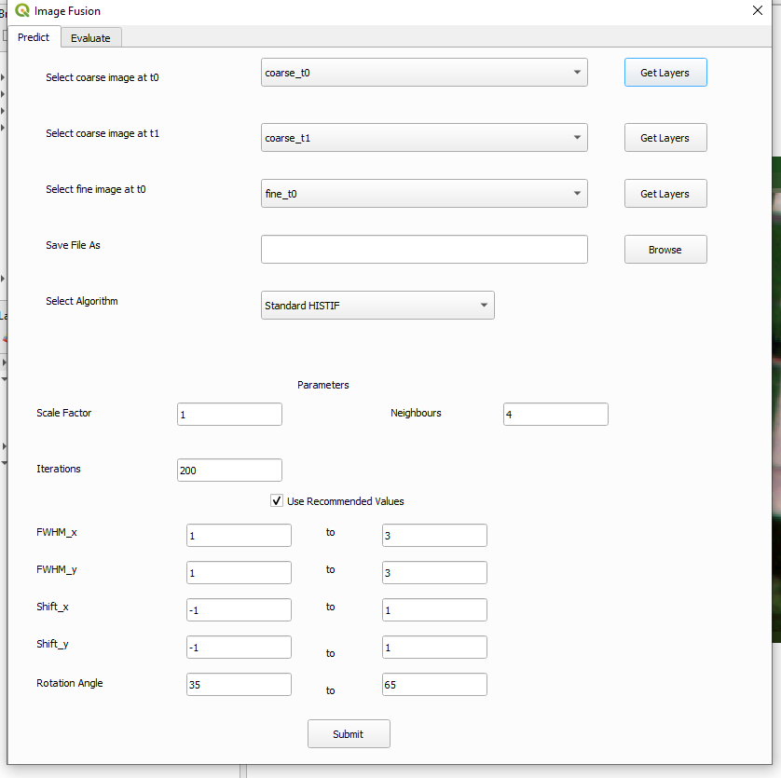
Step 1
Step 4
Step 3
Step 5
Step 6
Step 7
Step 8

Slide 6
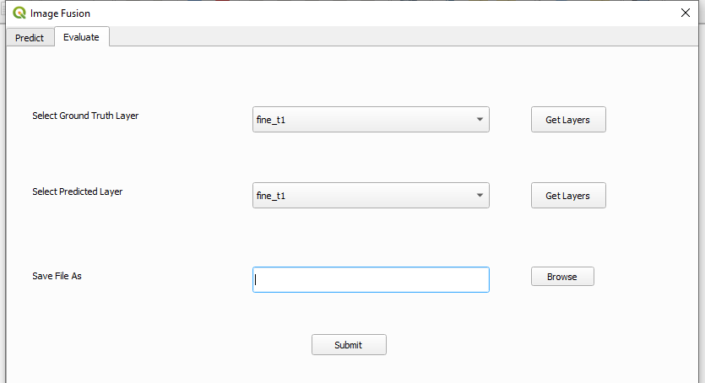
Image Fusion Evaluation
Step 1 : Click on Evaluate tab.
Step 2 : Load predicted file into QGIS.
Step 3 : Click on Get Layers button.
Step 4 : Select ground truth and predicted
layers from combo box.
Step 5 : Click browse button, select output
directory and enter output file name.
Step 6 : Click on submit button.
Step 1
Step 4
Step 3
Step 5
Step 6

Slide 7


